Slide 1
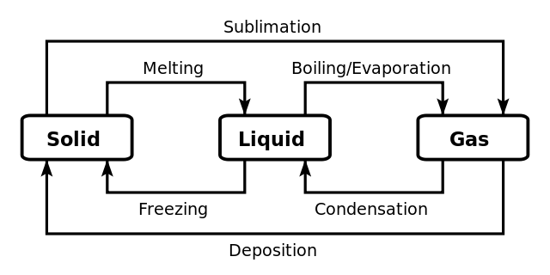
Changes of State Chapter 11.4-11.7
Changes of state occur when pressure and temperature vary
From | To | Name | Temperature | Pressure
gas | liquid | Condensation | decreases | increases
gas | solid | Deposition | decreases | increases
liquid | solid | Freezing | decreases | increases
solid | gas | Sublimation | increases | decreases
solid | liquid | Melting/Fusion | increases | decreases
liquid | gas | Evaporation | increases | decreases
This can be summarized in a diagram

Slide 2
Phase Change Between Liquid and Gas
First we are going to study the change of phase between liquid and gas

Slide 3
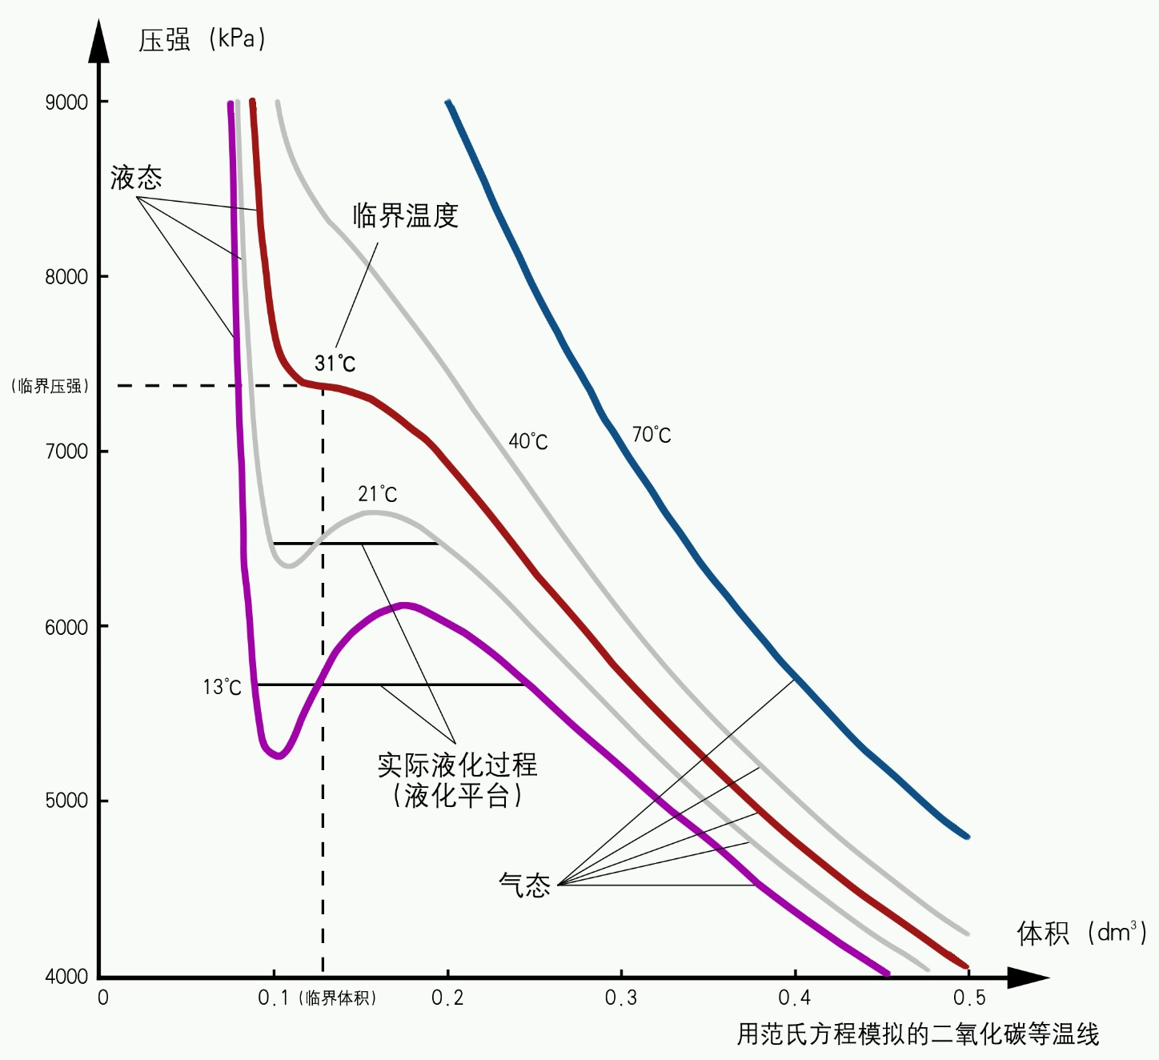
Real Fluids
First we are going to study the change of phase between liquid and gas.
In the first lecture we discussed how there were regions in which material could only be found in the liquid or gas phase while there were also conditions under which both phases could co-exist
P
Liquid
ONLY
Critical Point
Crit. Pres.
GAS & LIQUID
GAS ONLY
Volume
Crit. Vol.

Slide 4
Phase Change Between Liquid and Gas
As shown in the diagram for CO₂ at 13 ºC at point 1 there is only gas, but at point 2 there is only liquid. As we compress the gas, making the volume smaller, the gas is converted to liquid while the pressure stays the same
P
Liquid
ONLY
Critical Point
Crit. Pres.
2
1
GAS & LIQUID
GAS ONLY
Volume
Crit. Vol.

Slide 5
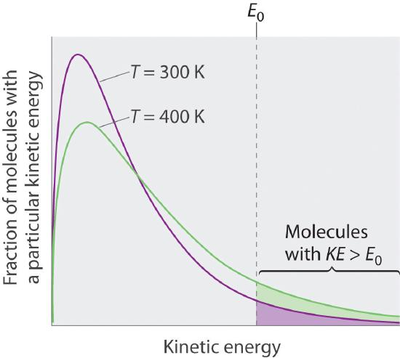
What is evaporation
At any temperature some molecules at the surface of a liquid have sufficient kinetic energy to escape from the liquid forming a vapor.
As the temperature increases the fraction of molecules at the surface that can escape increases.
If the container is open, the liquid will, over time, evaporate, more quickly when the temperature is higher

Slide 6
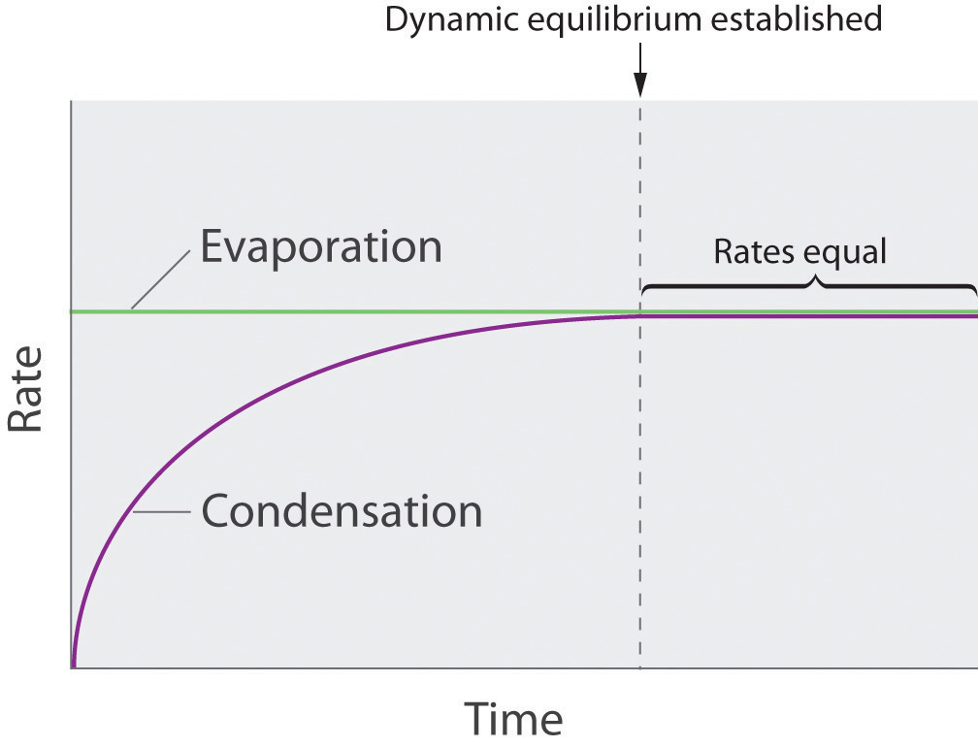
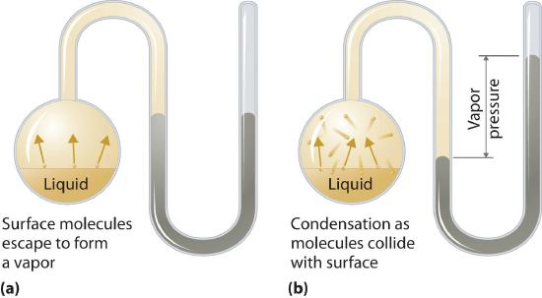
What is condensation
If the container is closed, some of the molecules will hit the surface and be returned to the liquid. This is called condensation
Eventually evaporation and condensation will occur at the same rate.
The pressure in the gas phase at equilibrium is called the vapor pressure

Slide 7
Vapor pressure
We can get an idea of the balance between evaporation and condensation using this applet from pHeT https://phet.colorado.edu/sims/ideal-gas/gas-properties_en.jnlp but you have to have installed JAVA or view this video from the University of Colorado

Slide 8
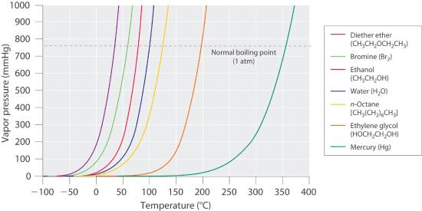
Vapor pressure
The vapor pressure is a result of equilibrium between vaporization and condensation.
The rate of vaporization depends on the kinetic energy of molecules at the surface
Therefore the rate of vaporization depends on temperature, the higher the temperature the higher the rate of vaporization.
The rate of vaporization also depends on the intermolecular force holding a molecule at the surface.
The weaker the intermolecular attraction, the higher the vaporization rate

Slide 9
Vapor pressure
The vapor pressure can be expressed as a function of the heat needed to vaporize a mole of a liquid, Δh_{vap} and the temperature T (K).
The temperature must be the absolute temperature.
The equation is called the Clausius-Clapyron equation
$\ln{p=}−\frac{∆H_{vap}}{R}\left(\frac{1}{T}\right)$ + C
We can also express the ratio of two vapor pressures at two different temperatures
$$ln\left(\frac{p_{2}}{p_{1}}\right)= −\frac{∆H_{vap}}{R}\left(\frac{1}{T_{2}}−\frac{1}{T_{1}}\right)$$

Slide 10
Boiling Point
The boiling point is defined as the temperature at which the external pressure equals the vapor pressure.
Since atmospheric pressure decreases with altitude the boiling point also decreases with altitude
Table 11.4.1 The Boiling Points of Water at Various Locations on Earth
Place | Altitude above Sea Level (ft) | Atmospheric Pressure (mmHg) | Boiling Point of Water (°C)
Mt. Everest, Nepal/Tibet | 29,028 | 240 | 70
Bogota, Colombia | 11,490 | 495 | 88
Denver, Colorado | 5280 | 633 | 95
Washington, DC | 25 | 759 | 100
Dead Sea, Israel/Jordan | −1312 | 799 | 101.4

Slide 11
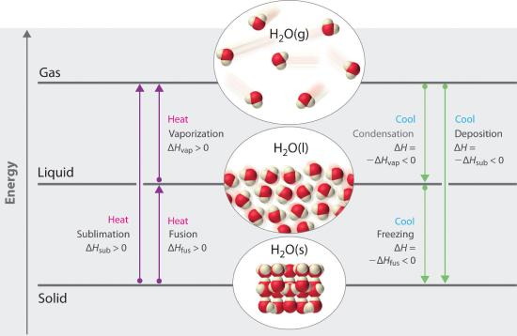
Change of State Enthalpys
We know that a change of state requires either heating or cooling, a stove or a refrigerator, a hot day or a cold one.

Slide 12
Phase Change Between Liquid and Gas
The temperatures at which a chemical substance changes state and the energy absorbed or emitted depends on the substance
Table 11.5.1 Melting and Boiling Points and Enthalpies of Fusion and Vaporization for Selected Substances
Substance | Melting Point (°C) | ΔH_{fus} (kJ/mol) | Boiling Point (°C) | ΔH_{vap} (kJ/mol)
N₂ | −210.0 | 0.71 | −195.8 | 5.6
HCl | −114.2 | 2.00 | −85.1 | 16.2
Br₂ | −7.2 | 10.6 | 58.8 | 30.0
CCl₄ | −22.6 | 2.56 | 76.8 | 29.8
CH₃CH₂OH (ethanol) | −114.1 | 4.93 | 78.3 | 38.6
CH₃(CH₂)₄CH₃ (n-hexane) | −95.4 | 13.1 | 68.7 | 28.9
H₂O | 0 | 6.01 | 100 | 40.7
Na | 97.8 | 2.6 | 883 | 97.4
NaF | 996 | 33.4 | 1704 | 176.1
We can attempt to draw simple relationships based on the intermolecular force and masses

Slide 13
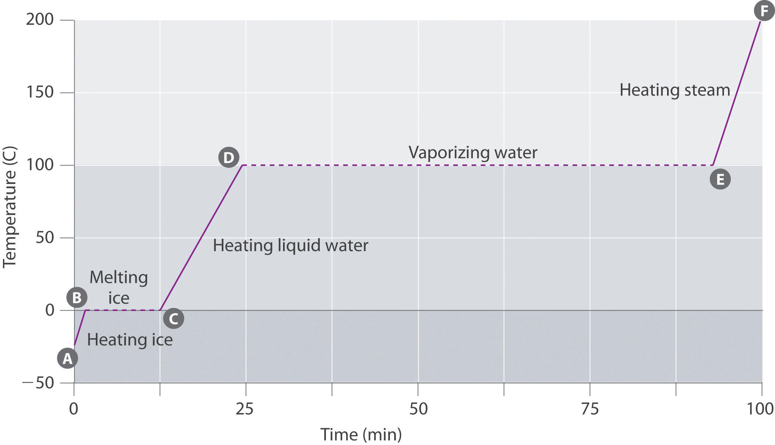
Heating Curves
If a substance absorbs a constant amount of heat per unit time and we monitor the temperature we measure a heating curve
The temperature during a phase changes is constant (B→C D→E
but increases uniformly when there is only one phase present. (A→B, C→D and E→F)
This is because the heat capacity is of a single phase is (roughly) constant as a function of temperature and ΔT= Q/C_{p} where Q is the heating rate and C_{p} the specific heat, both constants

Slide 14
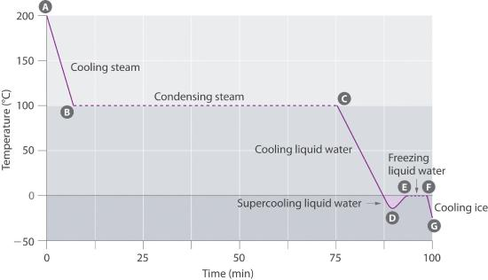
Cooling Curves
Cooling curves are very similar to heating curves with the difference that heat is being removed from the substance under study and one passes from the gas to the liquid to the solid phases

Slide 15
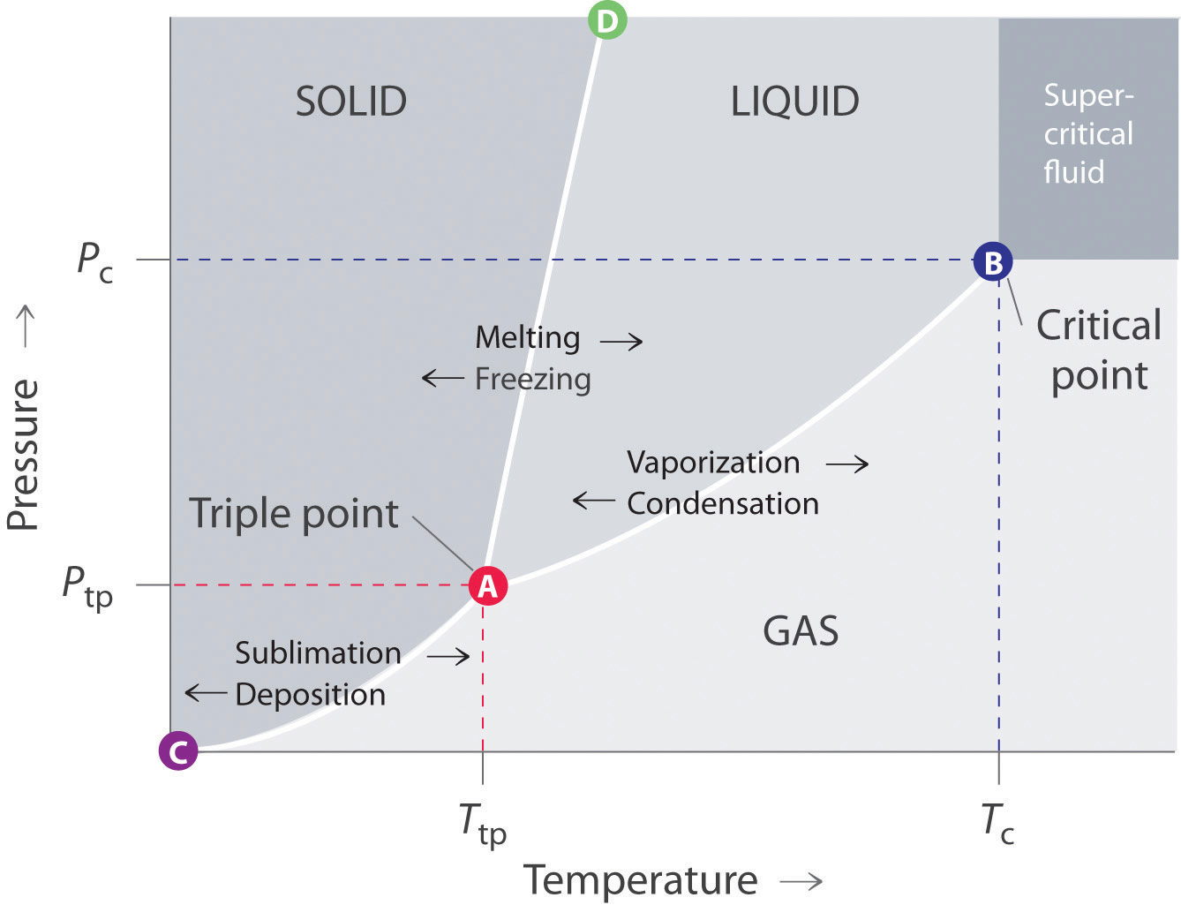
Phase Diagrams
This type of phase diagrams shows which phases of pure materials exist under different conditions of temperature and pressure.
We are now going to explore this simple phase diagram in greater detail

Slide 16
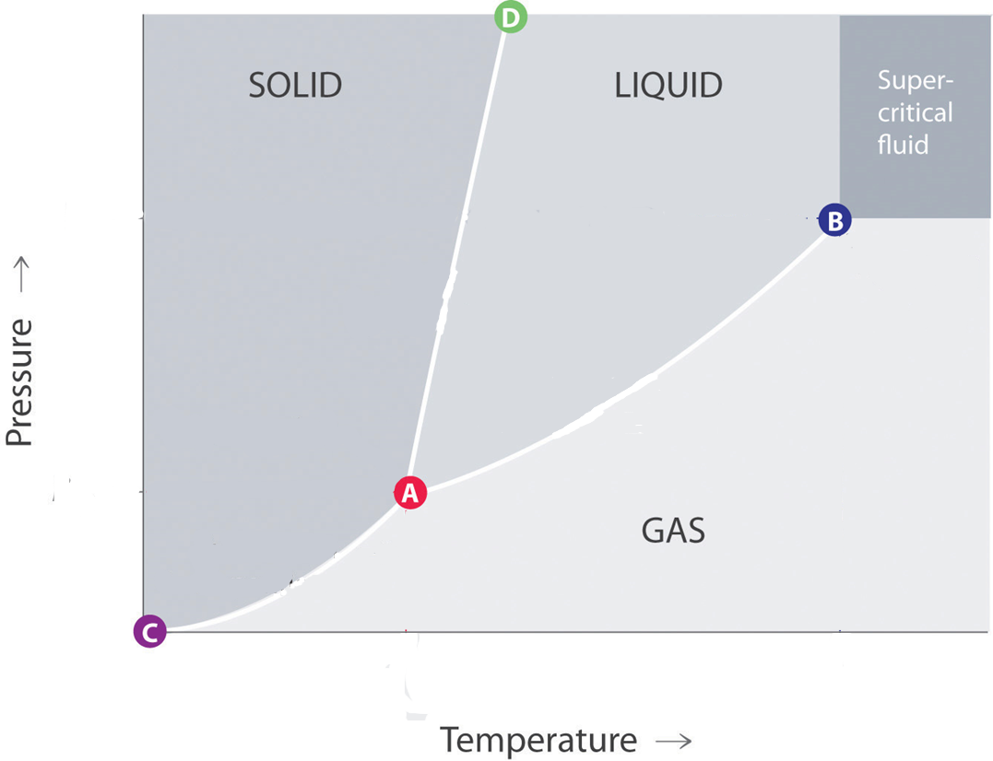
Phase Diagrams for Dummies
A simple phase diagram shows the conditions under which the solid, liquid, gas and supercritical gas phases exist.
The solid phase exits at high pressure and low temperature
The liquid phase exits at intermediate pressure and temperature
The gas phase exists at low pressure and high temperature

Slide 17
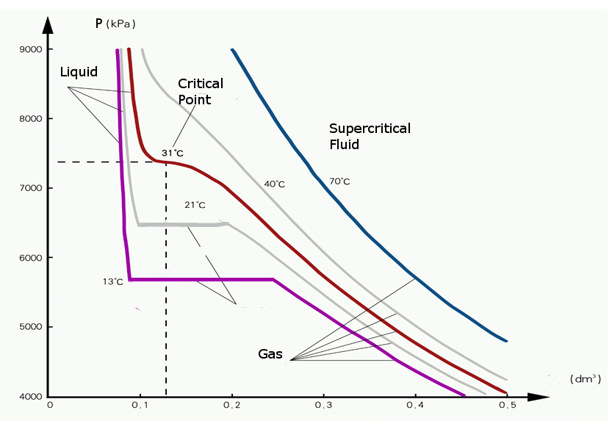
The Critical Point and Supercritical Fluids
Point B on the phase diagram is the critical point, the point beyond which there is no distinguishing between liquid and gas. The diagram shows the critical Temperature, Tc, pressure, Pc and volume, Vc. Using the vdW eq, knowing any two of these allows us to calculate the third.
Pc
Vc
Tc

Slide 18
The Critical Point and Supercritical Fluids
Point B on the phase diagram is the critical point, the point beyond which there is no distinguishing between liquid and gas. The diagram shows the critical Temperature, Tc, pressure, Pc and volume, Vc. Using the vdW eq, knowing any two of these allows us to calculate the third.
Vc

Slide 19
The Critical Point and Supercritical Fluids
Only a single phase exists in each of the colored areas. Within any of these the pressure and temperature can both be changed independently without a phase change occurring.
In these regions there are two degrees of freedom, both T and P can be varied at the same time, independently.
I

Slide 20
Two Phases: One Degree of Freedom
The white lines separate phases. Only on the white lines can two phases exist simultaneously.
For example the line A - B separates the liquid and gas phases. If one moved along the blue line, both phases would be present.
However if one moves off the white line separating two phases as shown by the red line there would be no liquid phase, all the liquid would turn in to gas
Moving along a line there is only one degree of freedom
Homework: What happens moving along the green line?

Slide 21
Three Phases: No Degrees of Freedom
Point A is called the triple point. There is only one combination of temperature and pressure where all three phases are present at the same time.
Pt
Tt

Slide 22
Phase Diagrams and Heating Curves
Temperature
Time
Homework: Draw a heating curve if one moves along the blue line. How does the pressure change?

Slide 23
Phase Diagrams and Heating Curves
Pressure
Time
Homework: Show how the pressure changes if as one moves along the blue line. Does the temperature change? If so how

Slide 24
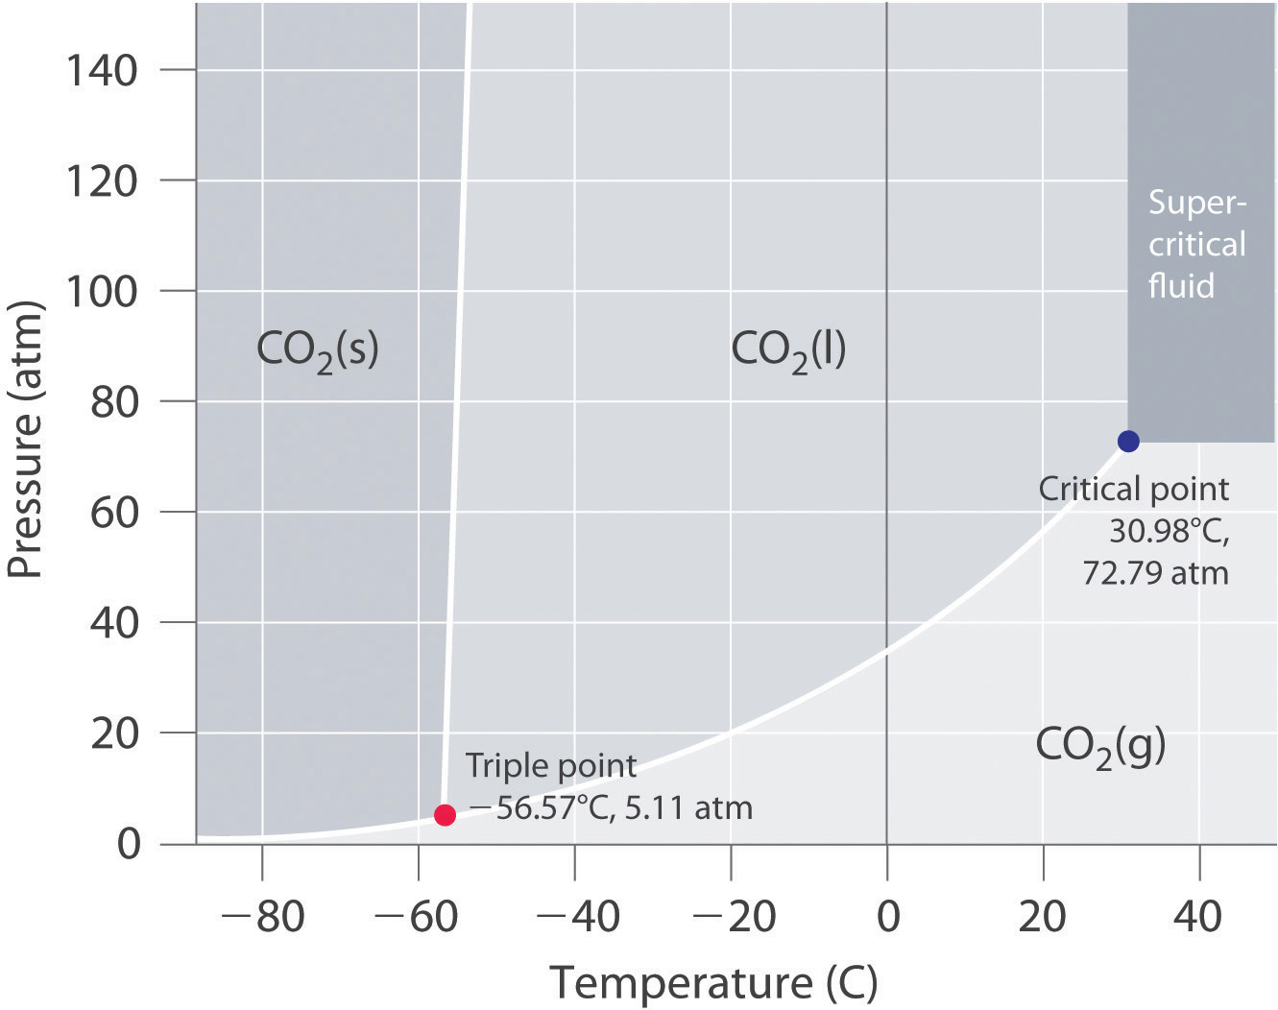
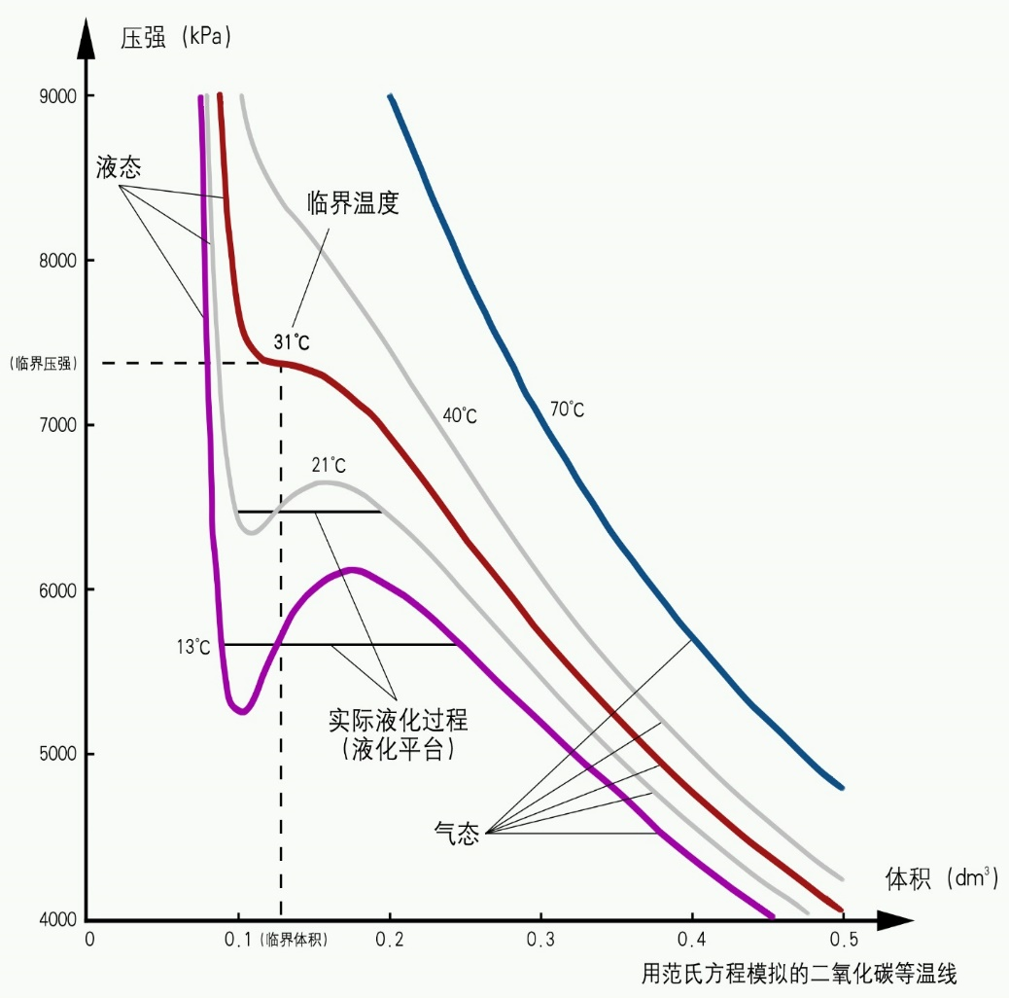
Phase Diagram for CO2
P
Liquid
ONLY
Critical Point
Crit. Pres.
GAS & LIQUID
GAS ONLY
Volume
Crit. Vol.

Slide 25
Phase Diagram for CO2
P
Liquid
ONLY
Critical Point
Crit. Pres.
GAS & LIQUID
GAS ONLY
Volume
Crit. Vol.

Slide 26
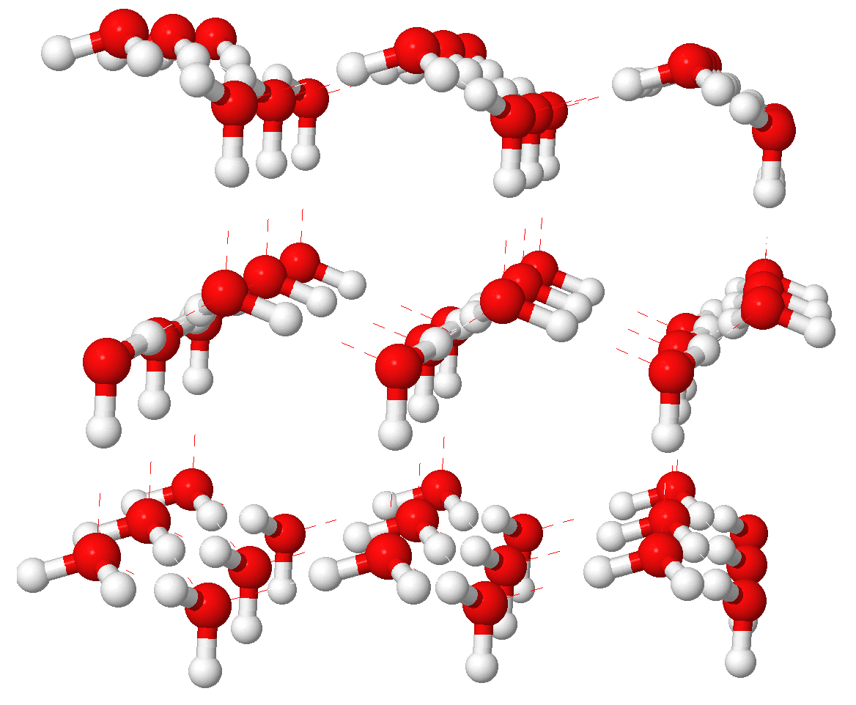
Structure of Ice
Ice formed at O C has an open structure consisting of hexagonal arrangements of water molecules. This open structure contributes to the relatively low density of ice, and is the reason that ice floats, the density of water being higher than that of ice.
Next week we will learn more about the structure of solids
From Wikimedia

Slide 27
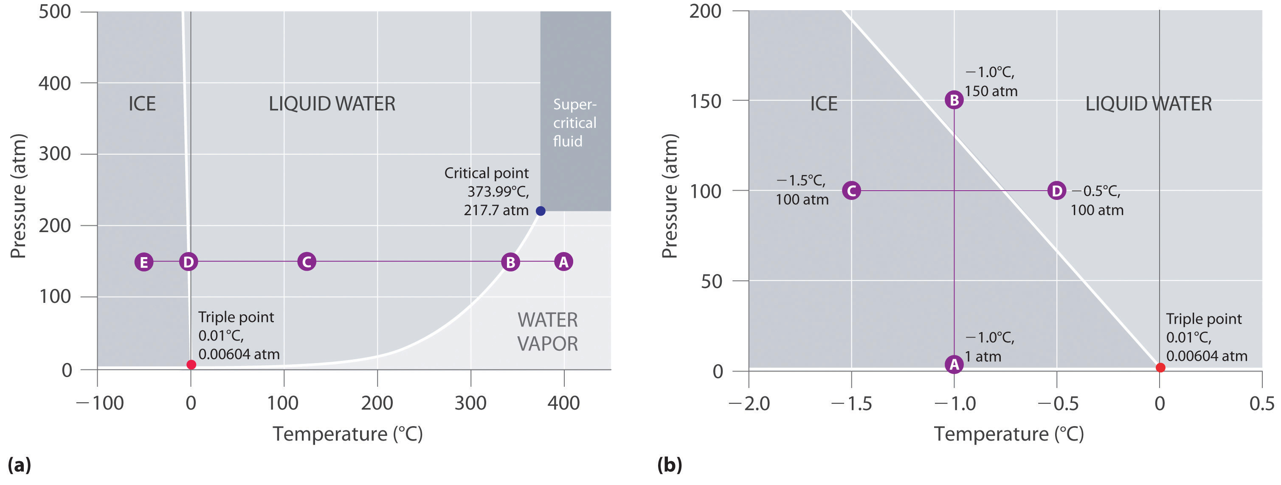
Phase Diagram for Water
Because ice is less dense than water, the line separating the solid and liquid has a negative slope. Thus as pressure is increased, ice will melt. This is shown in greater detail in the figure to the left

Slide 28
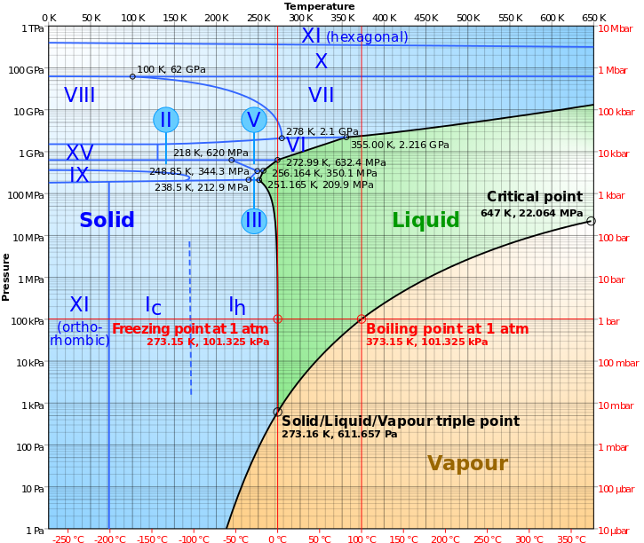
Real Phase Diagram for Water
From wikimedia

