Slide 1
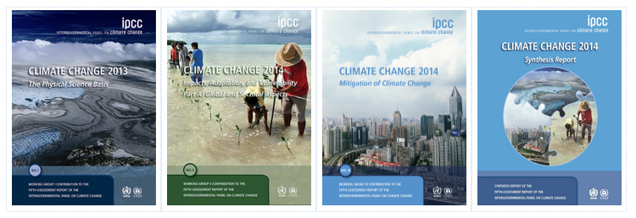
Climate Change 1
Understanding Radiative Forcing
IPCC (Intergovernmental Panel on Climate Change)
Review of all data relevant to climate change
Over 800 scientists from almost 40 countries
Five reports: 1990 – 2014
Nobel Peace Prize in 2007
2014: over 3500 pages
Photo courtesy IPCC

Slide 2
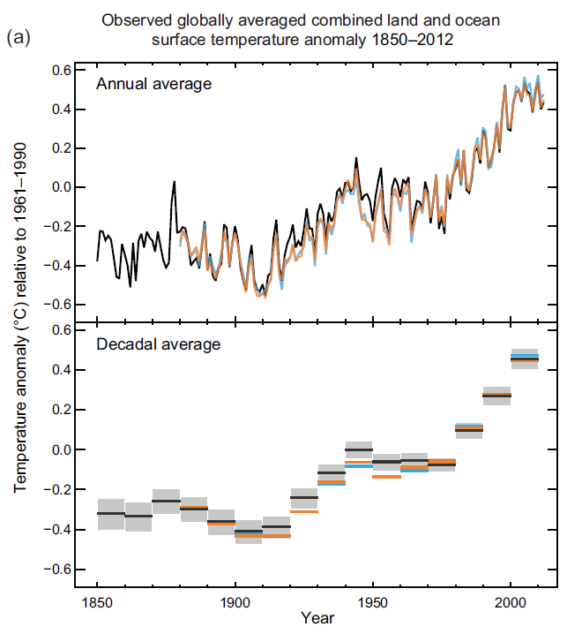
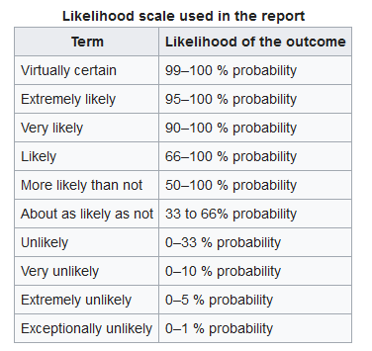
Climate Change 2
Understanding Radiative Forcing
IPCC (Intergovernmental Panel on Climate Change)
Figure & Text courtesy IPCC Summary for Policymakers

Slide 3
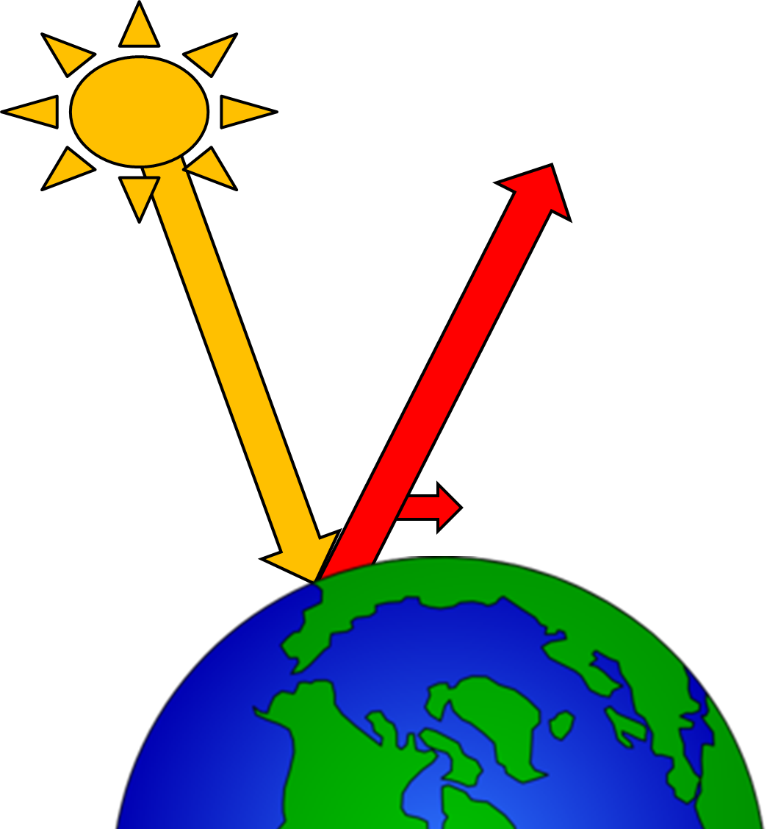
Climate Change 3
Understanding Radiative Forcing
IPCC (Intergovernmental Panel on Climate Change)
Radiative Forcing (RF): the affect a factor has on the Earth’s radiation budget
Factors: atmospheric constituent, land-use change
Positive RF: the factor warms the atmosphere
Negative RF: the factor cools the atmosphere
Relative to 1750 (pre-industrial revolution)
RF = Incoming Radiation – Outgoing Radiation

Slide 4
Climate Change 4
Understanding Radiative Forcing
IPCC (Intergovernmental Panel on Climate Change)
Radiative Forcing (RF): the affect a factor has on the Earth’s radiation budget (relative to 1750)
CO₂ has increased from 280 ppm (1850) to 400 ppm
RF = 1.68 W m^{–2}
Today, every m² of the Earth’s surface atmosphere is warmer by the equivalent of 1.68 W due to CO₂
RF = Incoming Radiation – Outgoing Radiation

Slide 5
Climate Change 5
Understanding Radiative Forcing
IPCC (Intergovernmental Panel on Climate Change)
Radiative Forcing (RF): the affect a factor has on the Earth’s radiation budget (relative to 1750)
CO₂ = 1.68 W m^{–2}
Other factors: CH₄, N₂O, CFCs, land use change…
Overall RF ~ 2.29 W m^{–2}
Uncertain: 1.13-3.33 W m^{–2}
Text courtesy IPCC Summary for Policymakers

Slide 6
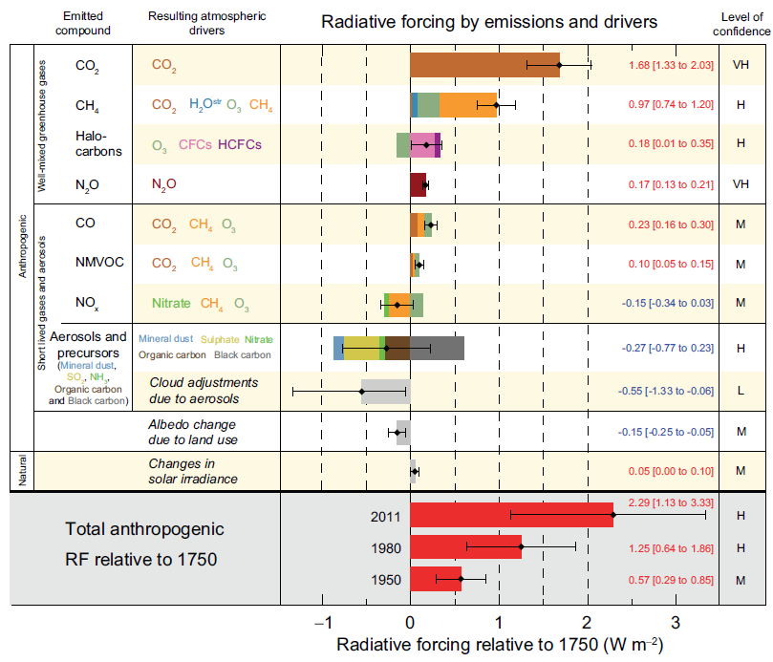
Climate Change 6
Understanding Radiative Forcing
Figure courtesy IPCC Summary for Policymakers

Slide 7
Climate Change 7
Understanding Radiative Forcing
Very High
High
Medium
cool
warm
How these affect GHGs
Human
Emissions
RFs
(with uncertainties)
Figure courtesy IPCC Summary for Policymakers

Slide 8
Climate Change 8
Understanding Radiative Forcing
Very High
High
Medium
Low
Aerosols
& Clouds
Land Use
Changes in Sun
Figure courtesy IPCC Summary for Policymakers

Slide 9
Climate Change 9
Understanding Radiative Forcing
Sums
2011
1980
1950

