Slide 1
Buffers
A buffer is a solution that can resist the addition of an acid or a base maintaining a nearly constant pH.
Buffers have a capacity, a limit beyond which addition of acids or bases results in large changes of pH
Buffers are mixtures of weak acids (bases) with their conjugate base (acid).
For example aqueous mixtures of
acetic acid with a soluble acetate salt
hydrofluoric acid with a soluble fluoride,
ammonium hydroxide with a soluble ammonium salt

Slide 2
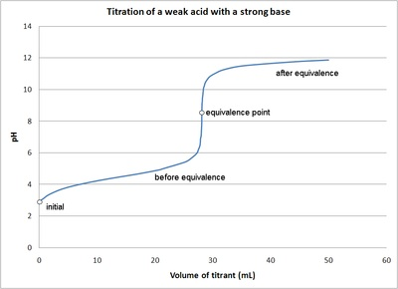
Titrations and Buffers
When we discussed the titration of a weak acid with a strong base we noted that there was a region around the midpoint of the titration where the pH remained roughly constant as we added base and in fact a considerable amount of base had to be added to significantly change the pH.
Notes:
https://en.wikipedia.org/wiki/Acid%E2%80%93base_titration

Slide 3
Common Ion Effect
In that region, adding a base will neutralize some of the H⁺ (aq) ions, increasing the pH. The decrease in the [H⁺ (aq)] ions will be compensated by the acid ionization reaction moving to the left
C₂H₄O₂(aq) = C₂H₃O₂⁻(aq) + H⁺ (aq)
producing additional H⁺ (aq) ion. The compensation is not perfect, pH increases by a small amount, but not as much as if base were added to pure water.
On the other hand, if an acid is added, that increases the H⁺ (aq)
Ion concentration and the reaction will compensate this by moving to the left. Again the pH will decrease but not by a significant amount

Slide 4
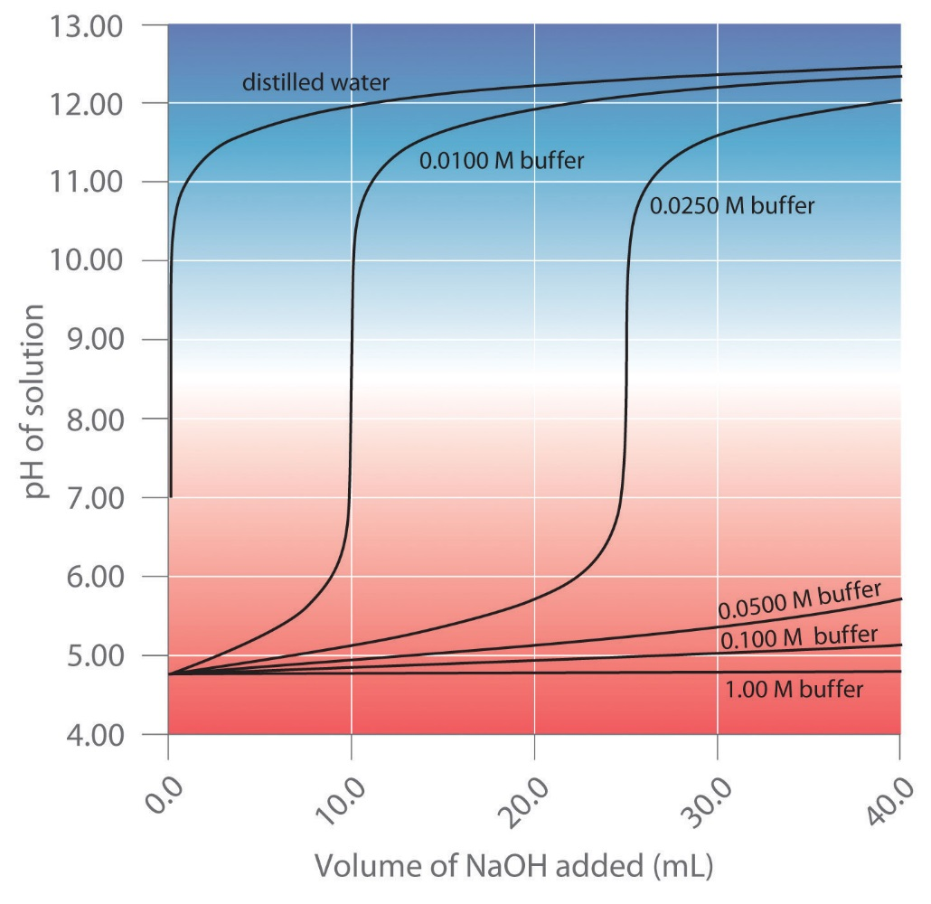
Buffer Range and Capacity
Buffers are characterized by their range and their capacity.
The center of the range is the midpoint of the titration where the concentration of the acid (base) and the counter ions are equal and pH=pK_{a}
The capacity is proportional to the molarity of the buffer solution. At higher molarities there are more acid (base) molecules and counter ions to react with added base or acid

Slide 5
Calculating pH of a Buffer
We can calculate the pH of an acidic buffer starting from the equilibrium constant
HA(aq) = A⁻(aq) + H⁺(aq)
$$Ka=\frac{\text{[}\text{A}\text{−}\text{]}\text{[}\text{H}\text{+}\text{]} }{\text{[}\text{HA}\text{]} }$$
This can be rearranged
$$\text{[}\text{H}\text{+}\text{]}=Ka \frac{\text{[}\text{H}\text{A}\text{]} }{\text{[}\text{A}\text{−}\text{]}}$$
And taking logarithms on both sides and multiplying by -1
$\text{−}\text{log}\text{ [}\text{H}\text{+}\text{]}=−log \left(Ka \frac{\text{[}\text{HA}\text{]} }{\text{[}\text{A}\text{−}\text{]}}\right)$ = -log K_{a} + log$\left(\frac{\text{[}\text{A}\text{−}\text{]} }{\text{[}\text{HA}\text{]}}\right)$
pH = pK_{a} + log$\left(\frac{\text{[}\text{A}\text{−}\text{]} }{\text{[}\text{HA}\text{]}}\right)$

Slide 6
Henderson – Hasselbach Equation
pH = pK_{a} + log$\left(\frac{\text{[}\text{A}\text{−}\text{]} }{\text{[}\text{HA}\text{]}}\right)$
Is called the Henderson Hasselbach equation and can be used to calculate the pH of a buffer if we know the pK_{a} and the concentrations of the acid and the conjugate base
pH = pK_{a} + log$\left(\frac{\text{[}\text{base}\text{]} }{\text{[}\text{acid}\text{]}}\right)$

Slide 7
Henderson – Hasselbach Equation
pH = pK_{a} + log$\left(\frac{\text{[}\text{A}\text{−}\text{]} }{\text{[}\text{HA}\text{]}}\right)$
An intermediate used in the synthesis of perfumes is valeric acid, also called pentanoic acid. The pK_{a} of pentanoic acid is 4.84 at 25°C.
What is the pH of a 0.259 M solution of pentanoic acid?
Sodium pentanoate is added to make a buffered solution. What is the pH of the solution if it is 0.210 M in sodium pentanoate?
What is the final pH if 8.00 mL of 0.100 M HCl are added to 75.0 mL of the buffered solution?
What is the final pH if 8.00 mL of 0.100 M NaOH are added to 75.0 mL of the buffered solution?

