Slide 1
pH
We should remind ourselves that
pH = -log₁₀ [H₃O⁺]
and
pOH = -log₁₀ [OH⁻]
where the equilibrium constant
K_{w} = [H₃O⁺][OH⁻] = 1 x 10⁻¹⁴
And
pK_{w} = 14 = pH + pOH

Slide 2
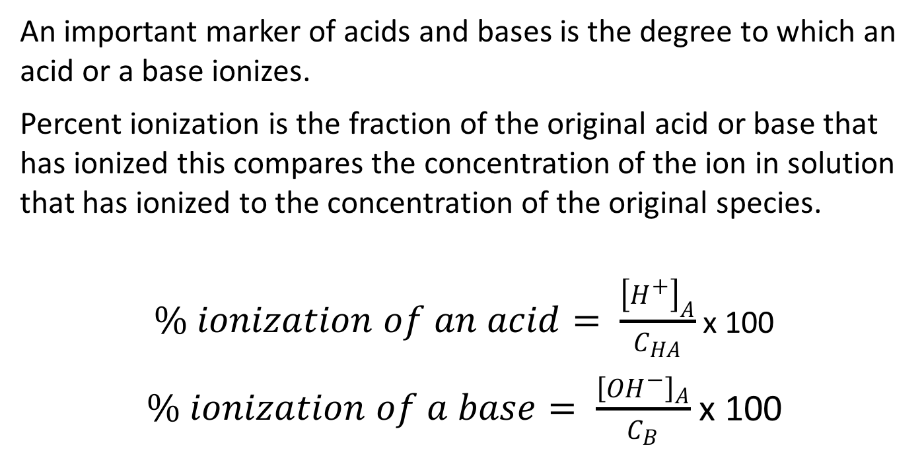
Percent Ionization
An important marker of acids and bases is the degree to which an acid or a base ionizes.
Percent ionization is the fraction of the original acid or base that has ionized this compares the concentration of the ion in solution that has ionized to the concentration of the original species.
$\% ionization of an acid= \frac{{\left[H^{+}\right]}_{A}}{C_{HA}}$ x 100
$\% ionization of a base= \frac{{\left[{OH}^{−}\right]}_{A}}{C_{B}}$ x 100

Slide 3
Some Examples
The hydronium concentration of a 0.10 M acetic acid solution is 1.3 x 10^{–3} M. The pH of the solution is? What is the percent ionization.
Seawater has a pOH of 5.90. What is its hydroxide-ion concentration? What is the percent ionization?
A solution has a pH value of 3.48. The OH– concentration for this solution is?
Calculate the pH of a 0.017 M Ba(OH)₂ solution.

Slide 4
Polyprotic Acids
Polyprotic acids can yield more than a single hydronium ion per acid molecule. Roughly speaking we can divide the problem into two cases. In the first case the first ionization is complete or almost complete. For example
H₂SO₄ (aq) + H₂O (l) → H₃O⁺(aq) + HSO₄⁻ (aq)
Followed by
HSO₄⁻ (aq) + H₂O (l) ↔ H₃O⁺(aq) + SO₄²⁻ (aq)
In this case K_{a1} is large and we can assume that all of the sulfuric acid is transformed to hydronium and bisulfate ions

Slide 5
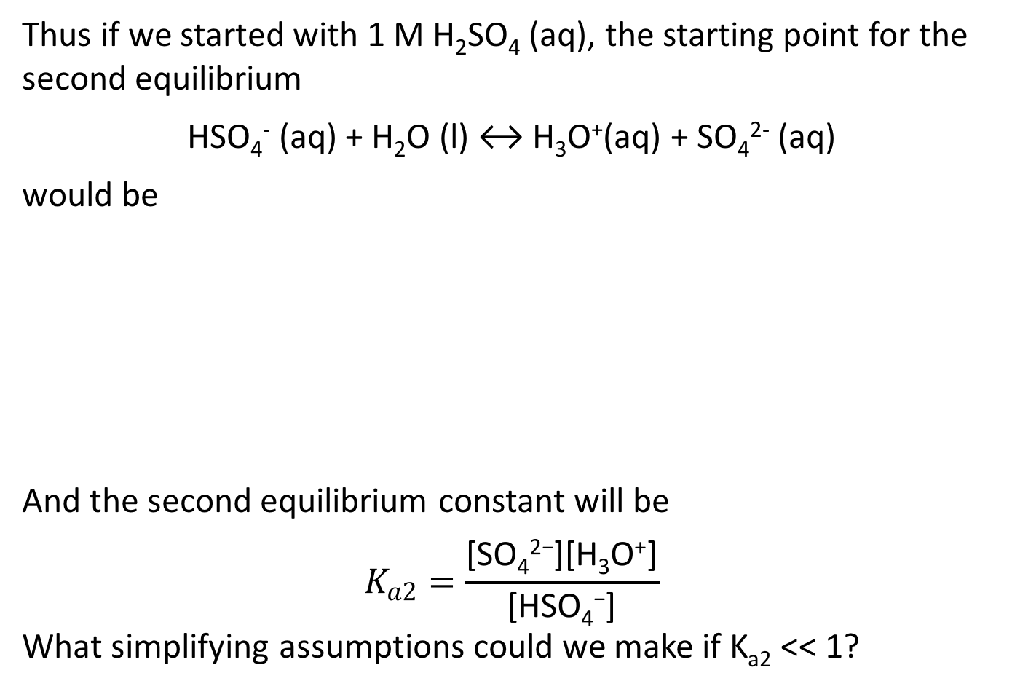
Strong Polyprotic Acids
Thus if we started with 1 M H₂SO₄ (aq), the starting point for the second equilibrium
HSO₄⁻ (aq) + H₂O (l) ↔ H₃O⁺(aq) + SO₄²⁻ (aq)
would be
And the second equilibrium constant will be
$$K_{a2}=\frac{\text{[}\text{SO}\text{4}\text{2−}\text{][}\text{H}\text{3}\text{O}\text{+}\text{]}}{\text{[}\text{HSO}\text{4}\text{−}\text{]}}$$
What simplifying assumptions could we make if K_{a2} << 1?
 | HSO₄⁻(aq) | H₃O⁺(aq) | SO₄²⁻ (aq)
Initial | 1M | 1M | 0
Change | -x | +x | +x
Equilibrium | 1M - x | 1M + x | x

Slide 6
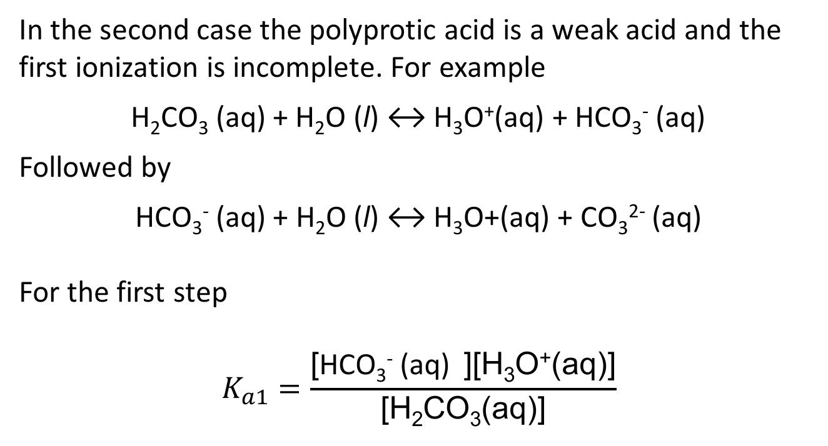
Weak Polyprotic Acids
In the second case the polyprotic acid is a weak acid and the first ionization is incomplete. For example
H₂CO₃ (aq) + H₂O (l) ↔ H₃O⁺(aq) + HCO₃⁻ (aq)
Followed by
HCO₃⁻ (aq) + H₂O (l) ↔ H₃O+(aq) + CO₃²⁻ (aq)
For the first step
$$K_{a1}=\frac{\text{[}\text{HCO}\text{3}\text{−}\text{ (}\text{aq}\text{) }\text{][}\text{H}\text{3}\text{O}\text{+}\text{(}\text{aq}\text{)]}}{\text{[}\text{H}\text{2}\text{CO}\text{3}\text{(}\text{aq}\text{)]}}$$

Slide 7
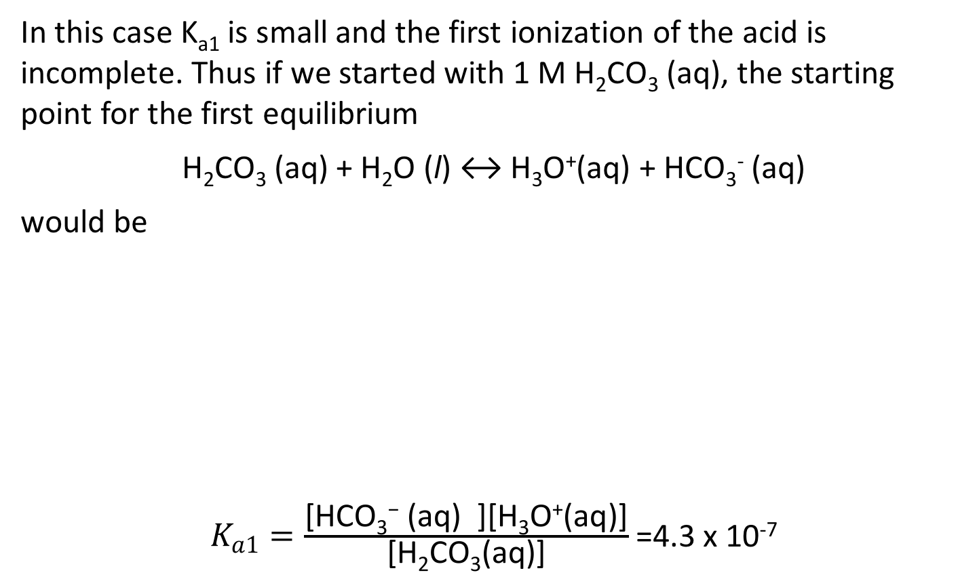
First Step for Weak Polyprotic Acids
In this case K_{a1} is small and the first ionization of the acid is incomplete. Thus if we started with 1 M H₂CO₃ (aq), the starting point for the first equilibrium
H₂CO₃ (aq) + H₂O (l) ↔ H₃O⁺(aq) + HCO₃⁻ (aq)
would be
$K_{a1}=\frac{\text{[}\text{HCO}\text{3}\text{−}\text{ (}\text{aq}\text{) }\text{][}\text{H}\text{3}\text{O}\text{+}\text{(}\text{aq}\text{)]}}{\text{[}\text{H}\text{2}\text{CO}\text{3}\text{(}\text{aq}\text{)]}}$ =4.3 x 10⁻⁷
 | H₂CO₃ (aq) | H₃O⁺(aq) | HCO₃⁻ (aq)
Initial | 1M | 0 | 0
Change | -x | +x | +x
Equilibrium | 1M - x | +x | +x

Slide 8
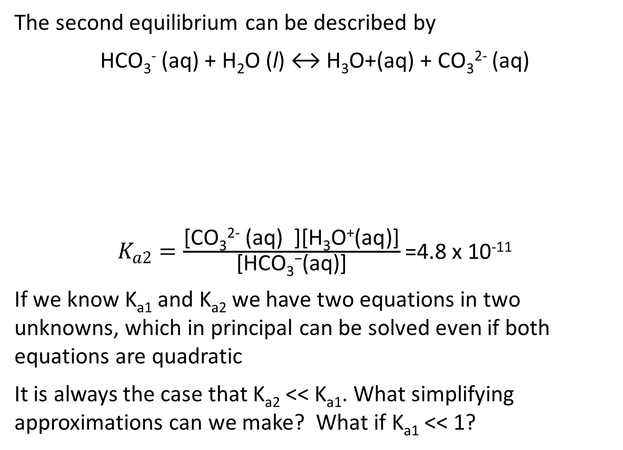
Second Step: Weak Polyprotic Acids
The second equilibrium can be described by
HCO₃⁻ (aq) + H₂O (l) ↔ H₃O+(aq) + CO₃²⁻ (aq)
$K_{a2}=\frac{\text{[}\text{CO}\text{3}\text{2−}\text{ (}\text{aq}\text{) }\text{][}\text{H}\text{3}\text{O}\text{+}\text{(}\text{aq}\text{)]}}{\text{[}\text{HCO}\text{3}\text{−}\text{(}\text{aq}\text{)]}}$ =4.8 x 10⁻¹¹
If we know K_{a1} and K_{a2} we have two equations in two unknowns, which in principal can be solved even if both equations are quadratic
It is always the case that K_{a2} << K_{a1}. What simplifying approximations can we make? What if K_{a1} << 1?
 | HCO₃⁻(aq) | H₃O⁺(aq) | CO₃²⁻ (aq)
Initial | 1M - x | +x | 0
Change | – y | +y | +y
Equilibrium | 1M – x – y | +x+y | +y

Slide 9
More Examples
What is the equilibrium constant for the following carbonic acid reaction? H₂CO₃ + 2H₂O ↔ 2H₃O+ + CO₃^{2–}
Here is a twist:
What is the CO₃²⁻ concentration in a solution that is 0.037 M in carbonic acid and 0.10 M HCl?

Slide 10
Hydrolysis (or Splitting of Water)
What is the effect of adding various salts to aqueous solutions?
We have already discussed this when we talked about the properties of acids and bases.
Implicit within the Bronsted-Lowry concept of conjugate acids and bases is the idea that ions produced in the ionization of weak acids (and bases) are themselves strong bases (or acids). For example
CN⁻ (aq) + H₂O (l) ↔ OH⁻ (aq) + HCN (aq)
The CN- ion can be formed, for example, in the ionization of NaCN. The Na+ ion, does not hydrolyze water
Na⁺(aq) + H₂O (l) No reaction

Slide 11
Four Cases
There are four cases which have to be considered if we want to know whether a salt solution will be basic or acidic.
 | Anion (-) | Cation (+)
Salt of a strong acid and strong base | No reaction | No reaction | Neutral
Salt of a weak acid and a strong base | Hydrolyzes (OH⁻) formed | No reaction | Basic
Salt of a strong acid and a weak base | No reaction | Hydrolyzes (H₃O⁺) formed | Acidic
Salt of a weak acid and a weak base | Hydrolyzes (OH⁻) formed K_{b}>K_{a} | Hydrolyzes (H₃O⁺) formed K_{a}>K_{b} | Ka >Kb acid Kb >Ka basic

Slide 12
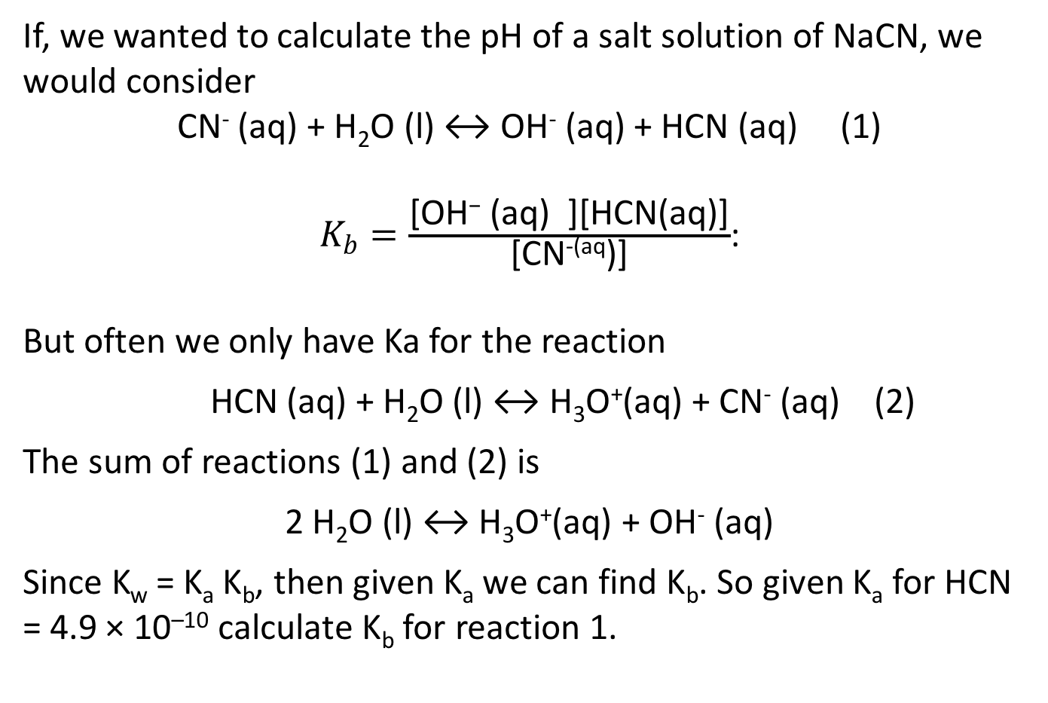
Calculating pH of Salt Solutions
If, we wanted to calculate the pH of a salt solution of NaCN, we would consider
CN⁻ (aq) + H₂O (l) ↔ OH⁻ (aq) + HCN (aq) (1)
$K_{b}=\frac{\text{[}\text{OH}\text{−}\text{ (}\text{aq}\text{) }\text{][}\text{HCN}\text{(}\text{aq}\text{)]}}{\text{[}\text{CN}\text{−(}\text{aq}\text{)]}}$:
But often we only have Ka for the reaction
HCN (aq) + H₂O (l) ↔ H₃O⁺(aq) + CN⁻ (aq) (2)
The sum of reactions (1) and (2) is
2 H₂O (l) ↔ H₃O⁺(aq) + OH⁻ (aq)
Since K_{w} = K_{a} K_{b}, then given K_{a} we can find K_{b}. So given K_{a} for HCN = 4.9 × 10^{–10} calculate K_{b} for reaction 1.

Slide 13
Common Ion Effect
What is the pH of a solution which is 0.0100 M in HA and also 0.0020 M in NaA (K_{a} = 9.0 × 10^{–6})
What happens if we add 100 ml of 1M HCl to 100 ml of 1M acetic acid (K_{a} = 1.7 x 10⁻⁵)?

