Slide 1
Colligative Properties
Colligative properties depend on the concentration of solute molecules or ions, but not upon the identity of the solute.
freezing point depression,
boiling point elevation,
vapor pressure lowering
osmotic pressure.

Slide 2
Raoult’s Law
Consider a binary solution with a single liquid phase solute
If we have a mixture of two liquids and we know the mole fraction of each, what other information do we need to know the total vapor pressure above the liquid and the composition of that vapor?
It turns out, that in many cases all we need to know is the vapor pressure of the pure substances.

Slide 3
Raoult’s Law
An ideal solution obeys Raoult’s law
P_{j} = x_{j}P_{j}⁰
the partial pressure in the vapor phase of each component of a mixture P_{j}
equals the mole fraction of that component in the solution x_{j}
multiplied by the vapor pressure above a pure solution of that liquid x_{j}P_{j}⁰

Slide 4
Ideal Liquid
In an ideal gases, molecules do not interact with each other.
That cannot be the case for an ideal solution, because both solute and solvent molecules must be attracted to each other in the liquid, otherwise it would never condense.
So what is an ideal solution? Well, we could use Raoult’s law and define an ideal solution as a solution that obeyed Raoult’s law, but a more physical one is that in an ideal solution, the interactions of solvent-solute are just the same as solvent-solvent in a pure solution.
A little thought will show that as the concentration of solute goes to zero all solutions behave ideally.
This means that the partial vapor pressure of any component of an ideal mixture varies linearly as the mole fraction in the liquid mixture.

Slide 5
Total Pressure in a Binary Mixture
A binary mixture has two components. If they are both liquid
P_{T} =P₁ +P₂
According to Raoult’s law
P₁=x₁P₁⁰ and P₂=x₂P₂⁰
So adding P₁ and P₂ up
P_{T}=x₁P₁⁰ +x₂P₂⁰
And since 1= x₁+x₂ or x₁ = 1-x₂
P_{T} =(1–x₂)P₁⁰ +x₂P₂⁰
Gathering terms with x₂
P_{T} =P₁⁰ +x₂(P₂⁰-P₁⁰)

Slide 6
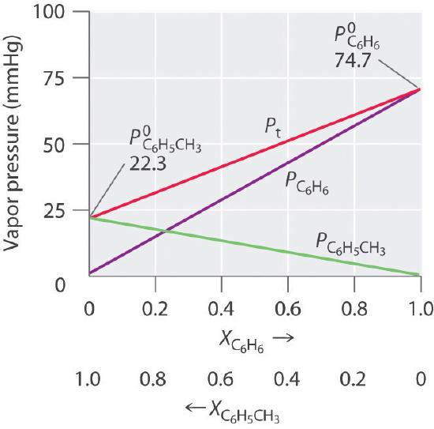
Graphical Representation
P_{T} =P₁⁰ +x₂(P₂⁰-P₁⁰)

Slide 7
Graphical Representation
P_{T} =P_{a}⁰ +x_{b}(P_{b}⁰-P_{a}⁰)
P_{a}⁰
P_{b}⁰
 |  | 130 | 50
Xa | xb | Pa | Pb | Pt
0 | 1 | 0 | 50 | 50
0.1 | 0.9 | 13 | 45 | 58
0.2 | 0.8 | 26 | 40 | 66
0.3 | 0.7 | 39 | 35 | 74
0.4 | 0.6 | 52 | 30 | 82
0.5 | 0.5 | 65 | 25 | 90
0.6 | 0.4 | 78 | 20 | 98
0.7 | 0.3 | 91 | 15 | 106
0.8 | 0.2 | 104 | 10 | 114
0.9 | 0.1 | 117 | 5 | 122
1 | 0 | 130 | 0 | 130

Slide 8
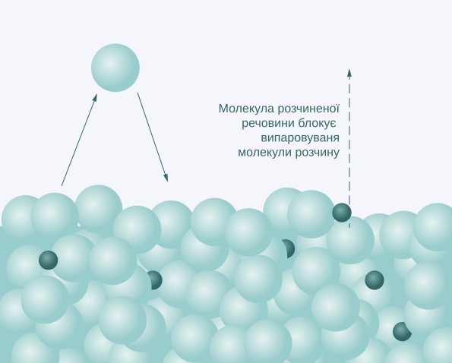
Molecular Basis of Raoult’s Law
Consider two different types of molecules on the surface. For an ideal solution the probability of either one making it into the gas phase is the same, so the composition in the vapor depends only on the relative number of each on the surface, or their mole fractions in the liquid solution.
Solvent molecule blocked from evaporation by the solute molecule
P₁=x₁P₁⁰ and P₂=x₁P₁⁰
https://upload.wikimedia.org/wikipedia/commons/thumb/e/e0/Molecular_basis_of_Raoults_law.svg/2000px-Molecular_basis_of_Raoults_law.svg.png

Slide 9
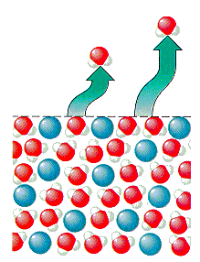
Vapor Pressure Depression
Now consider what happens if the solute has a zero vapor pressure (say the ions from an ionic salt, or sugar). Only the solvent molecules can enter the gas phase, but they only occupy a fraction of the surface. The non-volatile atoms/ions, block a portion of the surface proportional to their mole fraction, depression the vapor pressure of the volatile component
Surface
With solute
http://chemed.chem.purdue.edu/genchem/topicreview/bp/ch15/graphics/15_12.gif

Slide 10
Boiling Point Elevation
If we have a solution with a non-volatile solute then if we heat it to the normal boiling point of the solvent, the vapor pressure will be LOWER than the external pressure because solute molecules or ions are blocking part of the surface.
To increase the vapor pressure to the external pressure (1 atm at sea level) will require raising the temperature above the boiling point for the pure solvent
This is called boiling point elevation
http://chemed.chem.purdue.edu/genchem/topicreview/bp/ch15/graphics/15_12.gif

Slide 11
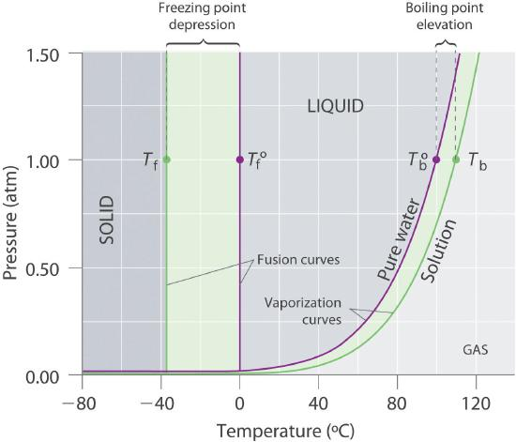
Boiling Point Elevation
Boiling point elevation is shown in the diagram to the left as
ΔT_{b}= T_{b}º - T_{b}
Note that it is always postiive
From our model it is straightforward to find that
ΔT_{b}=mK_{b}
Where m is the molality of the solution and K_{b} is a constant that depends only on the solvent.

Slide 12
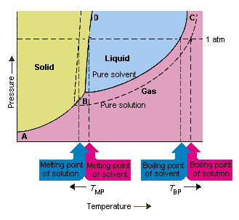
Freezing Point Depression
If we have a solution with a non-volatile solute the non-volatile solute will slow the rate at which molecules of the solvent can attach to the solid solvent phase.
This depresses the freezing point
ΔT_{f}=mK_{f}
Where ΔT_{b} is the freezing point depression and K_{b} is a constant
http://chemed.chem.purdue.edu/genchem/topicreview/bp/ch15/graphics/15_13.gif

Slide 13
Tables of Constants
Solvent | Boiling Point (°C) | K_{b} (°C/m) | Freezing Point (°C) | K_{f} (°C/m)
acetic acid | 117.90 | 3.22 | 16.64 | 3.63
benzene | 80.09 | 2.64 | 5.49 | 5.07
d-(+)-camphor | 207.4 | 4.91 | 178.8 | 37.8
carbon disulfide | 46.2 | 2.42 | −112.1 | 3.74
carbon tetrachloride | 76.8 | 5.26 | −22.62 | 31.4
chloroform | 61.17 | 3.80 | −63.41 | 4.60
nitrobenzene | 210.8 | 5.24 | 5.70 | 6.87
water | 100.00 | 0.51 | 0.00 | 1.86

Slide 14
Measuring Molecular Weights
Let us say we have a solution with a known mass of solute and a known mass of solvent.
We measure a freezing point depression.
From this we can find the molality of the solution.
Since we know the mass of the solvent, from this and the molality we can find the number of moles of solute.
Since we now know the mass of the solute and the number of moles of solute, we know the molecular weight!

Slide 15
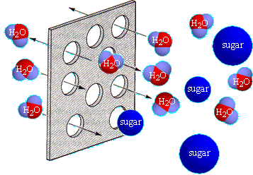
Osmosis
Semi permiable membranes have small openings which can allow smaller solvent molecules to pass in both directions while larger ones can only stay on the right side
Figure from UIUC

Slide 16
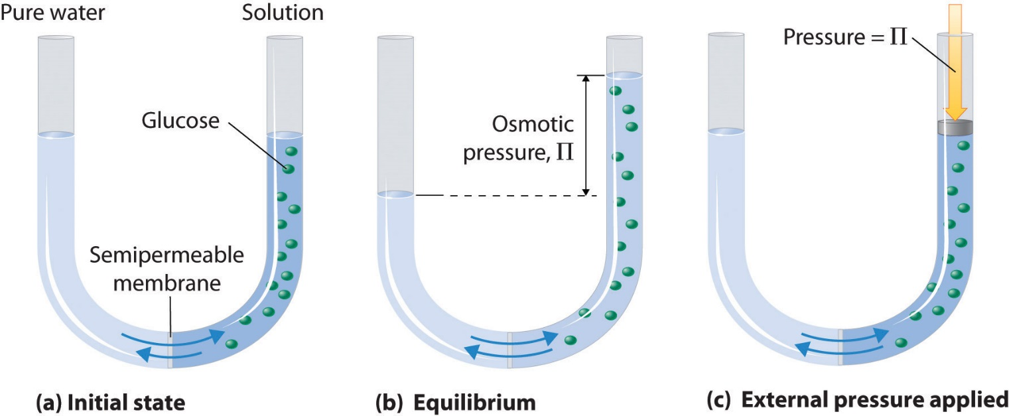
Osmotic Pressure
With pure solute in the left arm and a sugar solution in the right hand arm there will be a flow of solvent through the semipermeable membrane
The level in the right handed side will rise higher than the one in the left
The pressure needed to push down on the right handed side so both sides are level is the Osmotic Pressure (Π)

Slide 17
Osmotic Pressure
Π = $\frac{nRT}{V}$ = MRT
Notice that the osmotic pressure formula uses molarity, not molality

Slide 18
Ionic solutions
Colligative properties depend on the ratio of solvent molecules to everything else in the solution
If the solute is a completely ionized salt, the colligative propertieswill depend on the number of ions, not the number of formula units of the salt.
If a salt is not completely ionized, the apparent number of solute entities (both molecules and ions) can be described by the van’t Hoff factor
$$i=\frac{apparent number of solute particles in solution}{number of moles of solute dissolved}$$

Slide 19
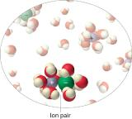
Ionic solutions
$$i=\frac{apparent number of solute particles in solution}{number of moles of solute dissolved}$$
In concentrated solutions of electrolytes like NaCl, some of the ions form neutral ion pairs that are not separated by solvent and diffuse as single particles. This would reduce the van’t Hoff factor for the concentrated solution below 2.
Compound | i (measured) | i (ideal)
glucose | 1.0 | 1.0
sucrose | 1.0 | 1.0
NaCl | 1.9 | 2.0
HCl | 1.9 | 2.0
MgCl₂ | 2.7 | 3.0
FeCl₃ | 3.4 | 4.0
Ca(NO₃)₂ | 2.5 | 3.0
AlCl₃ | 3.2 | 4.0
MgSO₄ | 1.4 | 2.0
To account for this the effective number of moles of solute are multiplied by the van’t Hoff factor.
Boiling Pt elevation: ΔT_{b}=imK_{b}
Freezing Pt depression: ΔT_{f}=imK_{f}
Osmotic Pressure: Π = iMRT

